Slide 1
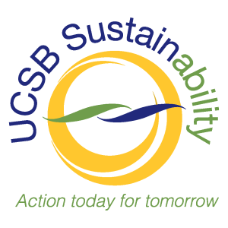
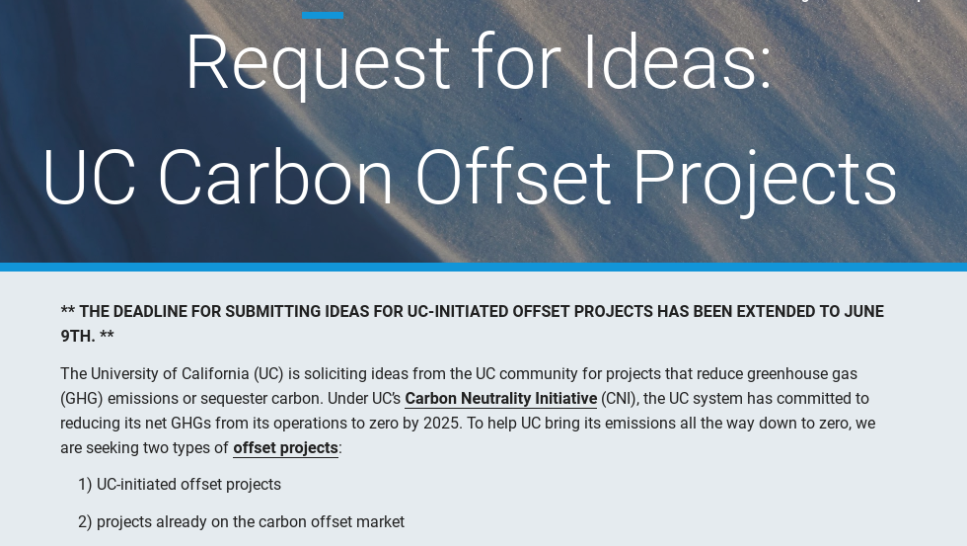
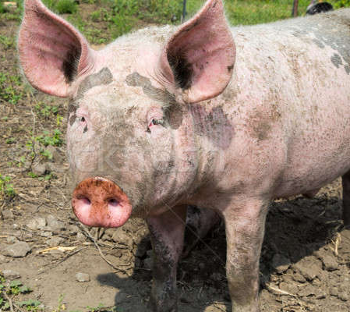
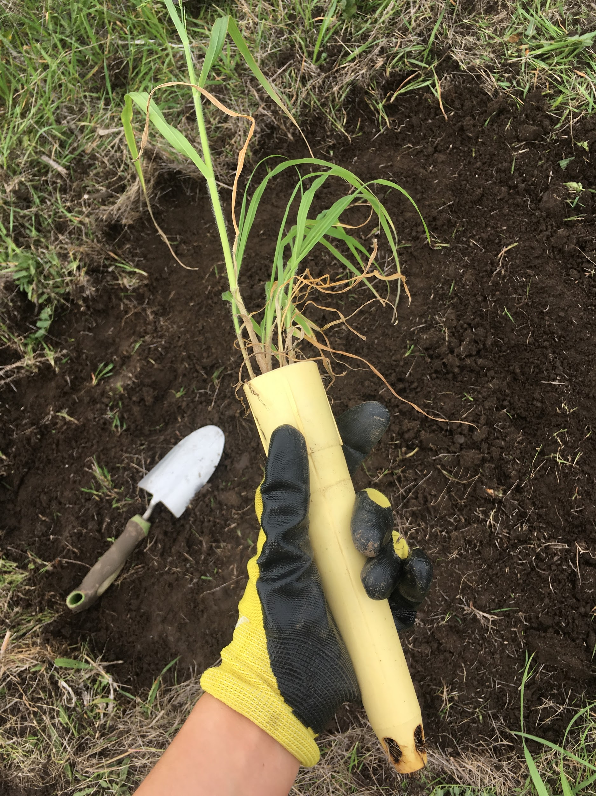
Applying Existing Knowledge on Voluntary
Carbon Offsets to Implement Local Projects Elizabeth Szulc
University of California Carbon Neutrality Initiative Fellowship
Introduction
Methods
Results
The 2018-2019 academic year was my second year holding my position as the Carbon Neutrality Initiative Fellow dedicated to carbon offsetting. Last year, my project focused on creating guidelines for carbon offset procurement at UCSB and included a guidebook: “How to Develop a Local Carbon Offset Program” to provide a resource for decision making on incorporating carbon offsets into our portfolio of strategies for Carbon Neutrality by 2025.This guidebook provided a theoretical overview and introduction to carbon offsets before moving through the steps of working with a third party registry to develop a voluntary carbon offset.
This year, my research involved building on this theoretical groundwork to explore the technical ins and outs of what it might look like for UCSB to actually develop a carbon offset project locally. My work focused on applying the ideas put forth in my guidebook to clarify the process of offset development through several technical case studies. In addition, this research involved trying to answer the tough questions associated with the often controversial practice of carbon offsetting to ensure ethical projects that generate real emissions reductions.
Identifying Potential Project Types and Partners
Work on this project began with brainstorming and identifying a diverse pool of potential projects that might be possible locally given the unique geographic situation of UCSB. These initial ideas included:
Conversion of Annual to Perennial Grasses
BioChar Application to Local Land
Tree Planting on Campus
Urban Forestry in the City of Santa Barbara or City of Goleta
Carbon Farming at Local Ranches
Capturing Methane from Gas Flare along Highway 101
Swine Manure Methane Management on Local Pig Farms
Working with the Goleta Sanitary District
A wide range of projects on nearby tribal lands
Reviewing Methodologies from Third-Party Registries
From these initial projects brainstormed, the next step was to check for the existence of applicable methodologies and protocols with third-party registries under which these projects would be eligible. As the University of California system currently reports its emissions to The Climate Registry, all carbon offsets reported need to undergo third-party verification. This step involved checking first to see if a related methodology even existed, to ensure there was scientific steps to calculating the baseline and emissions reductions of the projects. Next, identified methodologies were read closely to check if the eligibility criteria established in the methodologies would allow for the distinct local circumstances of the potential project.
Working to Establish Cost Estimates and More
With appropriate methodologies identified for some of the projects, I began to take a deeper dive into two specific projects: Grassland Restoration, and Swine Methane Management. For both of these projects, further data and information was gathered to provide an overview of the project, potential partners, cost estimates, and information on methodologies. This information was summarized in a project description write-up for each project. During the process of researching this information and compiling it in the write-ups, hard questions on carbon offsetting arose, such as how to address regulatory additionality, or whether scientific peer-review was more advantageous than going through third-party certification.
Request for Information
Around the time the write-ups on our two projects were completed, Dr. Barbara Haya and the folks at UCOP released the timeline and application for their UC-initiated carbon offset Request for Information. This opportunity to apply for one of ten $70,000 grants to develop an innovative carbon offset project provided the final structure of my fellowship year.
During this time, my roles involved providing Dr. Haya with initial feedback on the RFI application process, assisting various teams of researchers and stakeholders with preparing to go through the RFI application process, and preparing my own RFI proposal for the swine farm methane management project.
My final contribution to developing and implementing a real carbon offset project is my final submission of a Request for Ideas proposal for a Swine Methane Management project at a local swine farm called Pork Palace.
Furthermore, four other groups from UCSB submit their own RFI Proposals. I felt by encouraging each group to apply, answering questions about the process, and providing feedback on drafts of their proposals, I was able to support the submission of a successful and diverse round of proposals from UCSB.
Project Goals
Future of the Project
This project aimed to move from introductory and general research on how to go about developing a local carbon offset project to prepare for actual implementation of UC-initiated carbon offset projects near UCSB. This involved:
Identifying potential local project types, and potential project partners
Reviewing methodologies from third-party voluntary carbon registries to find what might fit those projects with respect to applicability and eligibility
Working to establish cost estimates for potential projects, including on the ground development costs, cost per ton of carbon abated, and staff time.
Exploring and debating difficult questions surrounding carbon offsetting
Assisting campus faculty, researchers, and local stakeholders in the application process for UCOP’s Request for Information for UC-initiated carbon offset projects
Submitting a Request for Information Proposal for a local swine farm methane management project.
Next year, a new Carbon Neutrality Initiative Fellow will be hired to continue the work related to carbon offsets.
In addition, our Request for Information proposal on Swine Methane Management will be undergoing the vetting and selection process over the next few months. This project may be selected for an extended proposal, before being potentially selected for funding. Whether this project is funded or not this year, it has paved the way to implementing carbon offset procurement at UCSB.
Acknowledgements
I would like to thank:
Jewel Persad, for supervising me along the way for the past two years of my fellowship
Katie Maynard, for supervising me during my second year of my fellowship
Barbara Haya, for providing enriching conversation, helpful answers, and general passion and excitement about the RFI application process

